Slide 1

What Metrics Determine Housing Prices? June 12, 2021 Zeray Admasu, Joanne Gates, John-Francis Kraemer, and Sumitha Prabhu
Deal or No Deal with Seattle Housing Prices
For Discussion Purposes Only

Slide 2
What Metrics Determine Housing Prices?
What metrics determine housing prices in the Seattle metropolitan area? And are they easily available?
Do these metrics have a strong individual correlation to prices or is it strong as a group correlation?
Can these metrics be used to train machine learning techniques (linear regression, random forest, and neural networks) to help predict house prices?
Which machine learning methodologies will provide the most accurate predictions?
Can mean absolute error (MAE), mean square error (RMSE), root mean squared error (MSE) be used to assess the reliability of the best machine learning methodology?

Slide 3
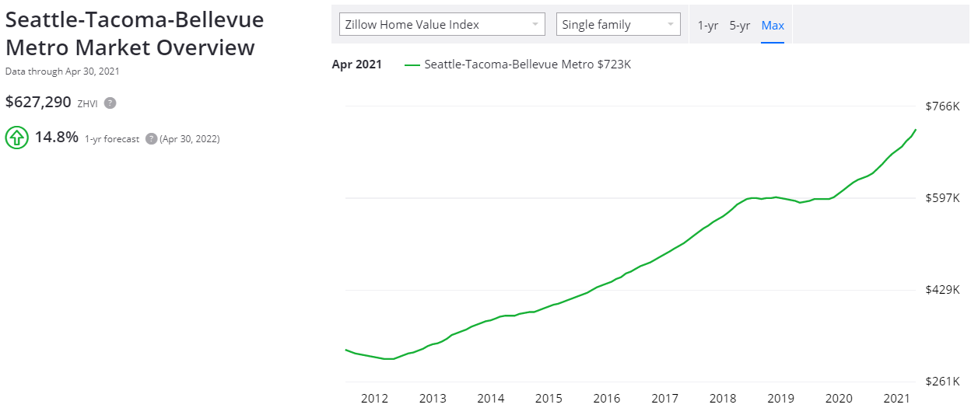
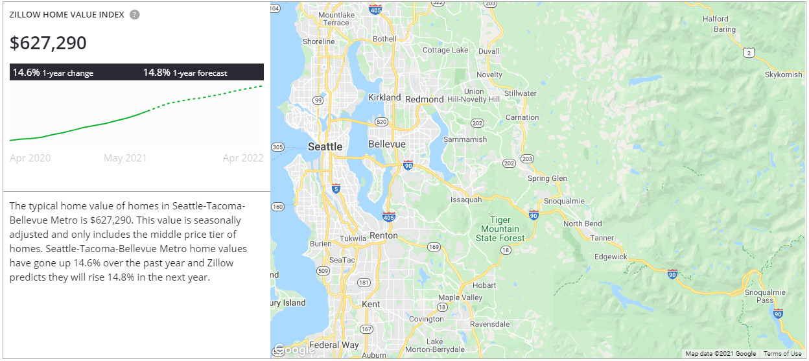
Seattle Housing Prices - Overview
Single family houses increased +14.8% in the past 12 months (Apr-21 vs. Apr-20) and +107.0% (Apr-21 vs. Apr-13)
Source: Zillow (https://www.zillow.com/seattle-tacoma-bellevue-metro-wa_r395078/home-values/)

Slide 4
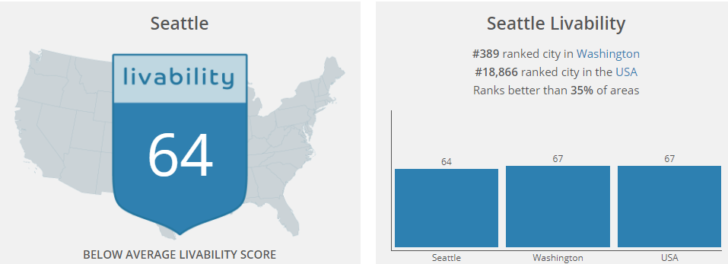
Seattle Housing Prices – Housing Data
Researched individual single-family homes sold and active in the Seattle metropolitan area for the past two months (April and May 2021)
Total housing metrics include an inventory of 4,18 homes that sold or are actively listed for sale
Identified the house price as the dependent variable (y) and metrics to be used independent variables (X) include:
# of bedrooms
# of bathrooms
House square feet
Land square feet
Livability Index¹
Note:
¹ Livability Index quantifies the quality of a city/town’s amenities, cost of living, crime rates, employment opportunities, and school district
Source: https://www.areavibes.com/seattle-wa/livability/

Slide 5
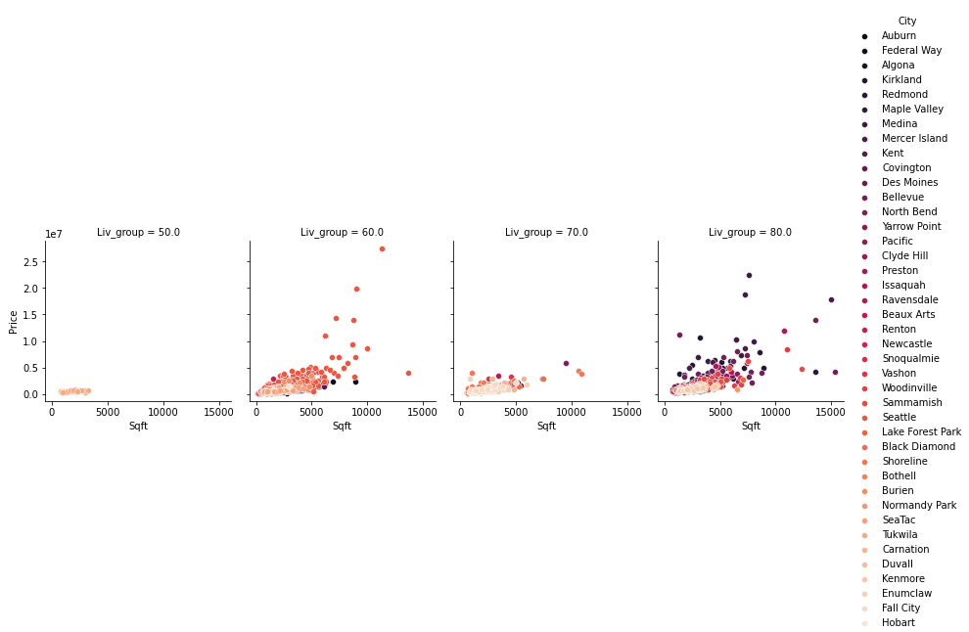
Seattle Housing Prices – Housing Data
Seattle metro area towns include the following segmented by livability index:

Slide 6
Seattle Housing Prices – Data Cleanup
Update
TBD

Slide 7
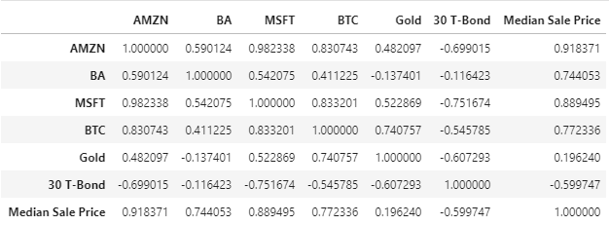
Seattle Housing Prices – Correlation
Update
Calculated individual correlation of 42 Seattle neighborhoods and surrounding town median housing prices by month over the past 9 years against the prices of Amazon, Microsoft, Boeing, Tableau, Zulily, Gold, Bitcoin, 30-year Treasuries
Identified the assets with the highest correlation to historical median housing prices
High correlation between median housing prices with AMZN (.92) and MSFT (.89)

Slide 8
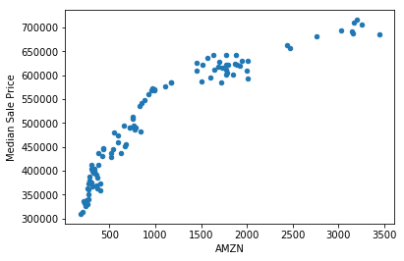
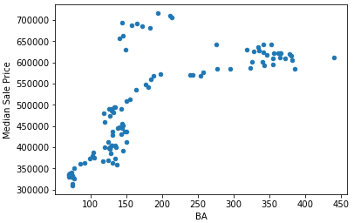
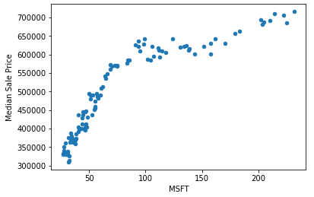
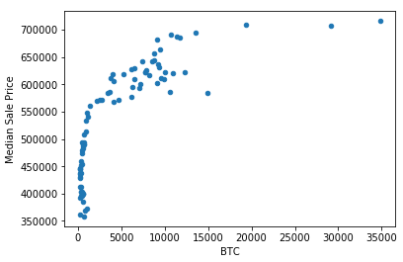
Seattle Housing Prices – Correlation
Update
Correlation charts of AMZN, BA, MSFT, and BTC against median housing prices

Slide 9
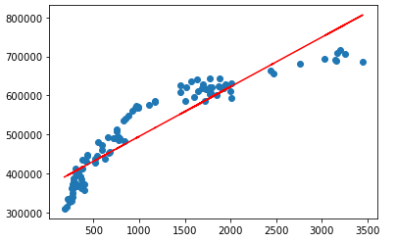
Seattle Housing Prices – Linear Regression
Update
Calculated linear regression on identified metrics and housing prices
Imported Panda libraries
from sklearn.linear_model import LinearRegression
import statsmodels.api as sm
Linear Regression Equation
y = m(x) + b
m = slope
b = intercept
x = AMZN stock price
y = Median housing prices
r² = coefficient of determination (correlation squared)¹
Note:
¹ The coefficient of determination is a statistical measurement that examines how differences in one variable can be explained by the difference in a second variable, when predicting the outcome of a given event

Slide 10
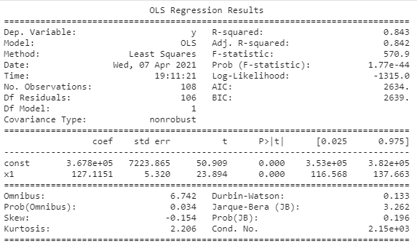
Seattle Housing Prices – Linear Regression
Update
Linear Regression Equation
y = m(x) + b
m = 127.11
b = 367,756
x = $3,372.20 (AMZN close on 4/9/21)
y = Median housing prices (today)
r² = 0.84
y = 127.11 * 3,372.20 + 367,756
y = $796,414.42
Based on the linear regression methodology, the current estimated linear equation is:
y = X(# of beds) + X(# of baths) + X(house sqft) + X(lot sqft) + X(town) + b

Slide 11
Seattle Housing Prices – Random Forest
Update
Linear Regression Equation
y = m(x) + b
m = 127.11
b = 367,756
x = $3,372.20 (AMZN close on 4/9/21)
y = Median housing prices (today)
r² = 0.84
y = 127.11 * 3,372.20 + 367,756
y = $796,414.42
Based on the random forest methodology, the current estimated equation is:
y = X(# of beds) + X(# of baths) + X(house sqft) + X(lot sqft) + X(town)

Slide 12
Seattle Housing Prices – Neural Network
Update
Linear Regression Equation
y = m(x) + b
m = 127.11
b = 367,756
x = $3,372.20 (AMZN close on 4/9/21)
y = Median housing prices (today)
r² = 0.84
y = 127.11 * 3,372.20 + 367,756
y = $796,414.42
Based on the neural network methodology, the current estimated linear equation is:
y = X(# of beds) + X(# of baths) + X(house sqft) + X(lot sqft) + X(town)

Slide 13
Seattle Housing Prices – Comparison
Update
Linear Regression Equation
y = m(x) + b
m = 127.11
b = 367,756
x = $3,372.20 (AMZN close on 4/9/21)
y = Median housing prices (today)
r² = 0.84
y = 127.11 * 3,372.20 + 367,756
y = $796,414.42
Based on the linear regression methodology, the current estimated linear equation is:
y = X(# of beds) + X(# of baths) + X(house sqft) + X(lot sqft) + X(town)

Slide 14
Seattle Housing Prices – Conclusion
Update
TBD

Slide 15

Questions

Slide 16
Appendix – TBD
TBD

Slide 17
Appendix – TBD
TBD

